Slide 1
BAD CUSTOMER DETECTION
Roman Burekhin
Thien An Trinh
Shoaib ahmed khan
Joy Vahini Varatharaajah
Athira Devan
Pratheep kumar venkatrangam
Ahmad AlHammad
Esther Yu

Slide 2
Contents
Business Value
Exploratory Data Analysis
Data preprocessing
Default models
Tuning model
Feature selection
Retune model with new refined data
Threshold Analysis

Slide 3



1. Business VALUE
Purpose: predicting default on a loan among individuals (bad client detection)
Model relevance:
credit risk reduction
reduction of banks' reserves, and, accordingly, profit growth, due to an advanced approach to assessing credit risks.
Who is interested in this model:
Any financial institutions
Marketplaces
Example:
- Raiffeisen bank case: decrease in reserves by 27 billion rub. (550 million CAD) in Russia in 2020 *
* Source: https://www.raiffeisen.ru/about/investors/annualreport/

Slide 4
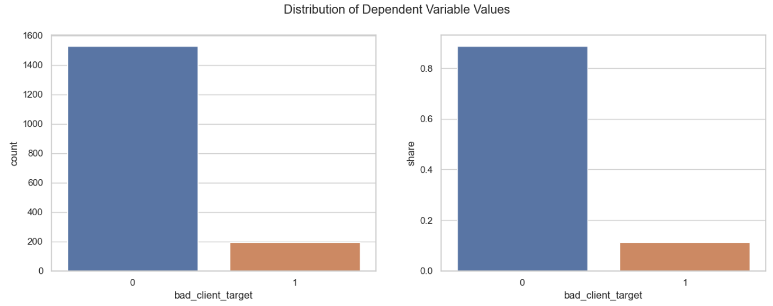
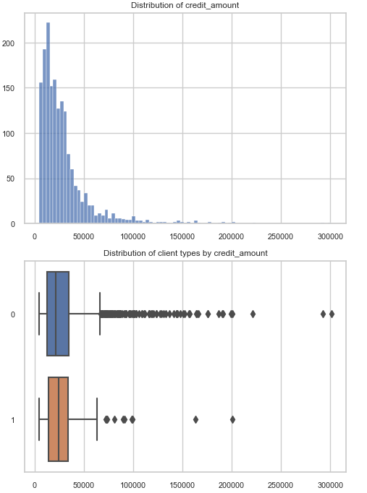
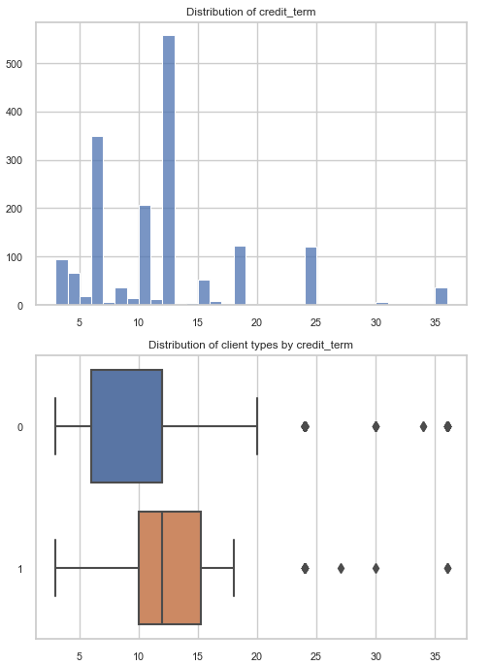
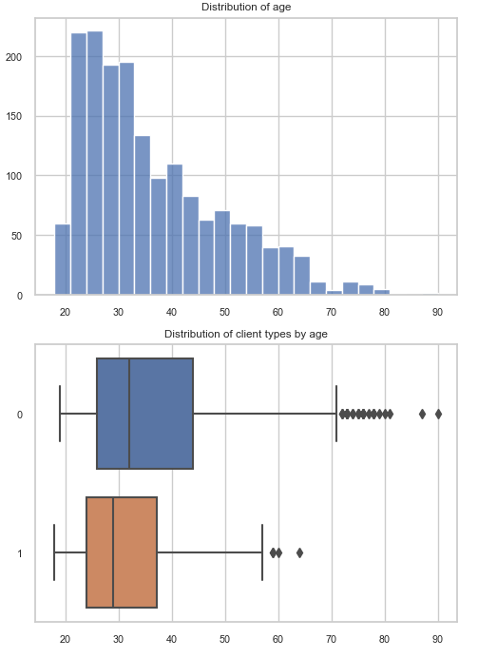
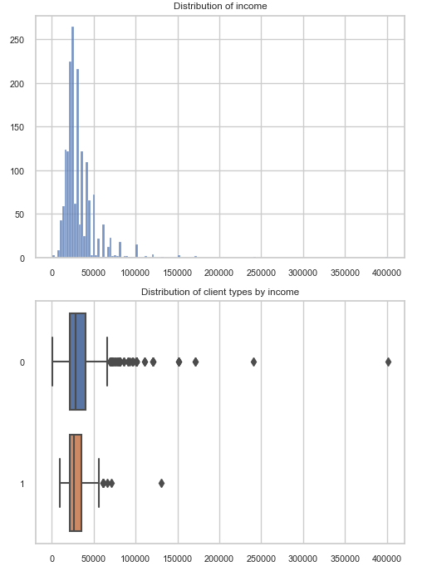
2. Exploratory Data Analysis
Dependent Variable
Bad_client_target
Independent Variable
Numerical Variable
Credit_amount
Credit_term
Age
Income
Categorical Variable
Month
Sex
Education
Product_type
Having_children_flg
Region
Family_status
Phone_operator
Is_client
Credit_Amount
Credit_Term
Age
Income

Slide 5
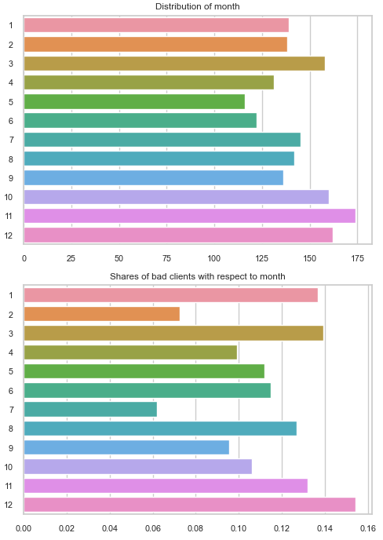
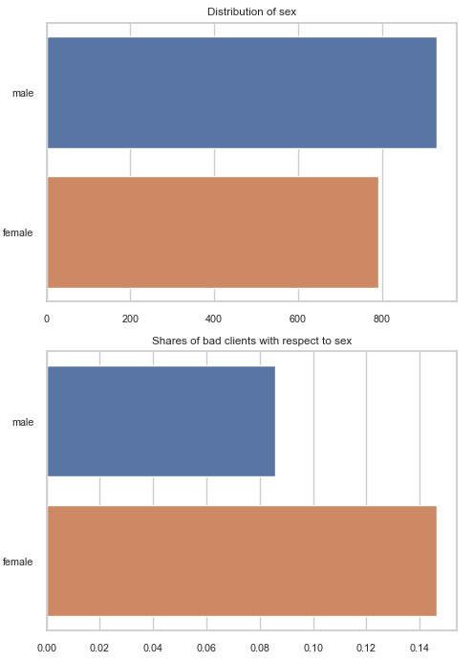
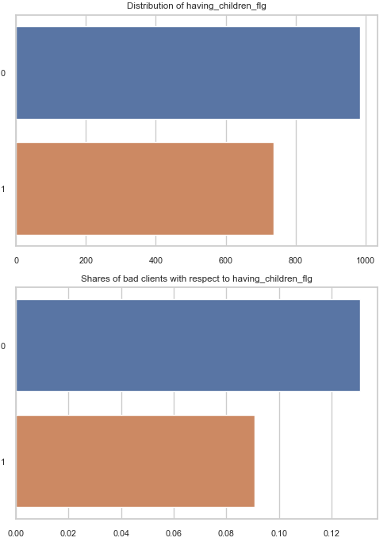
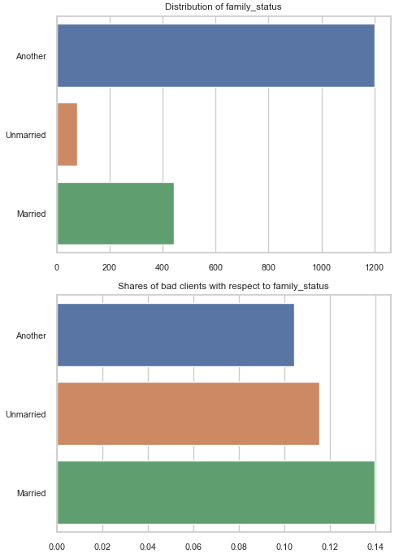
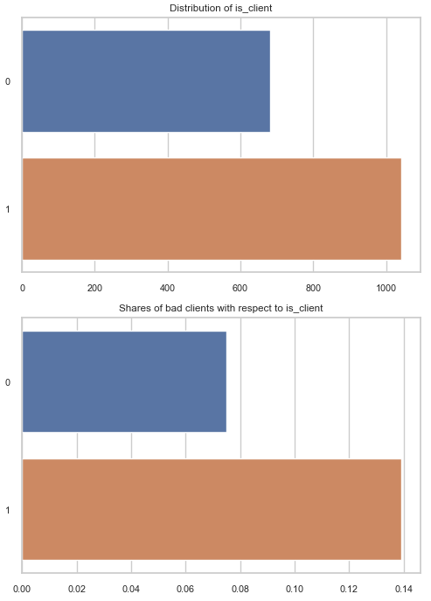
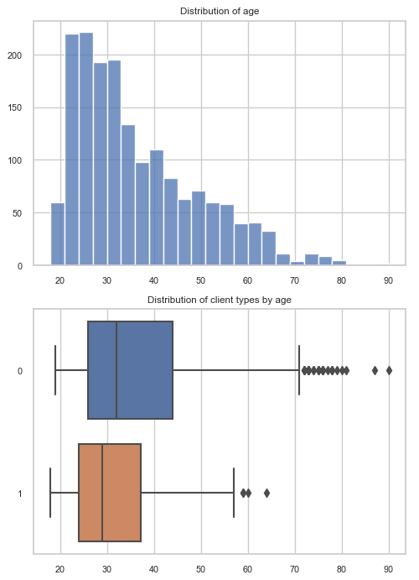
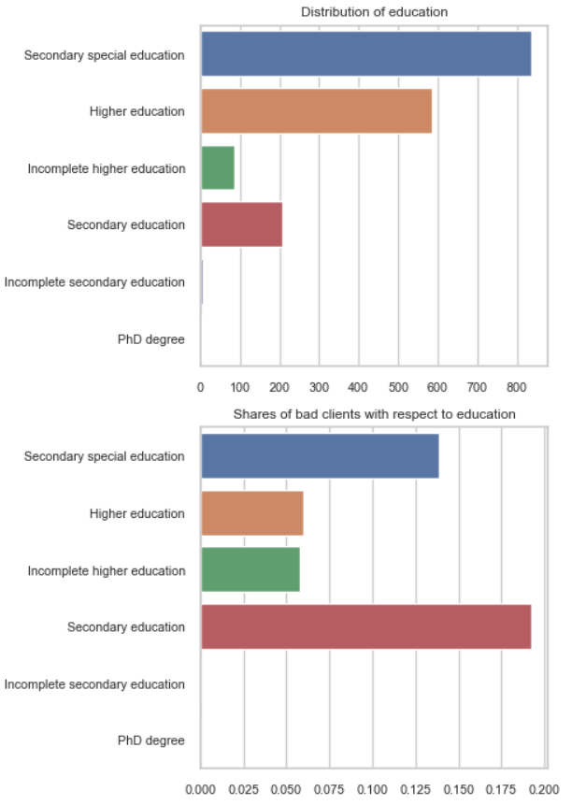
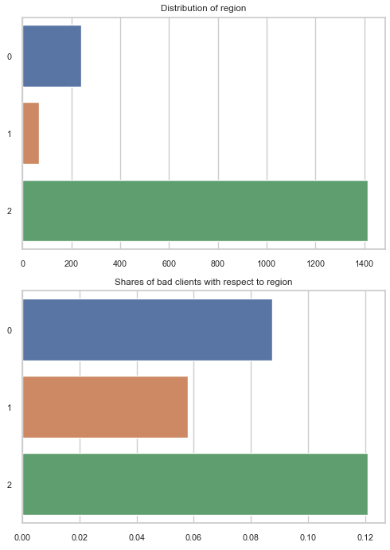
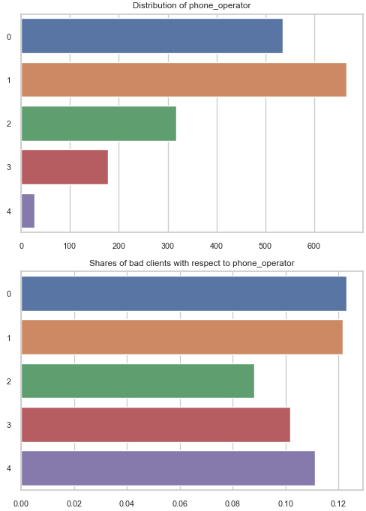
Month
Sex
Having_children_flg
Family_status
Is_client
Age
Education
Phone Operator
Region
Most bad client are in December, minority are in July
There are outliers in credit amount.
Bad clients having credit time
Female are bad client more frequently
People with only secondary education are bad clients more frequently
It seems that loan for cell phone is the most risky
People with children are less risky clients
People from region 3 are riskier
There are outliers in income
Marriage status, phone operator don’t influence the probability of client default
Clients of bank are more risky

Slide 6
3. Data preprocessing
One hot encoding: Essential process of converting the categorical data variables to be provided to machine and deep learning algorithms which in turn improve predictions as well as classification accuracy of a model
Education
education_Higher education
education_Incomplete higher education
education_Incomplete secondary education
education_PhD degree
education_Secondary education
education_Secondary special education
Product_type
product_type_Audio & Video | product_type_Repair Services
product_type_Auto | product_type_Sporting goods
product_type_Boats | product_type_Tourism
product_type_Cell phones | product_type_Training
product_type_Construction Materials | product_type_Windows & Doors
product_type_Fitness | product_type_Household appliances
product_type_Furniture | product_type_Cosmetics and beauty services
product_type_Garden equipment | product_type_Fishing and hunting supplies
product_type_Jewelry | product_type_Childen_good
product_type_Medical services | product_type_Clothing
product_type_Music | product_type_Computers
Family_status
family_status_Another
family_status_Married
family_status_Unmarried
sex
Sex_female
Sex_male

Slide 7
4. Default models
Train and test split
Splitting ratio
Test Samples : Train Samples
30% : 70%
517 images : 1206 images
Bad_client_target | Train images
0 | 1073
1 | 133
Bad_client_target | Test images
0 | 454
1 | 63

Slide 8
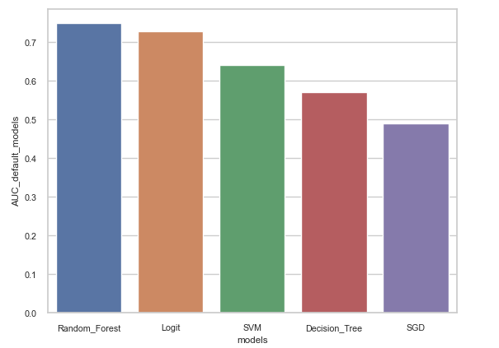
Models | AUC default models
Random Forest | 0.74
Logit | 0.72
SVM | 0.64
Decision Tree | 0.57
SGD | 0.49
The best default model is Random Forest

Slide 9
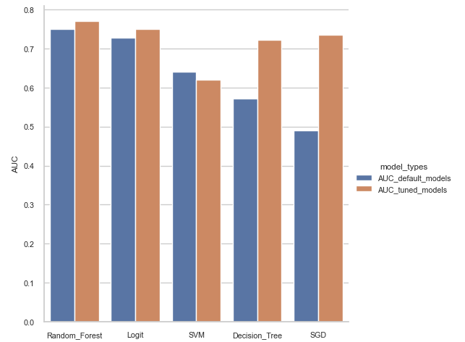
5. Tuning model
Models | AUC default models | AUC tuned models
Random Forest | 0.74 | 0.77
Logit | 0.72 | 0.74
SVM | 0.64 | 0.62
Decision Tree | 0.57 | 0.72
SGD | 0.49 | 0.73
The best model is Random Forest
With:
Criterion = gini
Max_depth = 6
Max_features = 7
N_estimators = 100
All of the models attained better AUC results except SVM

Slide 10
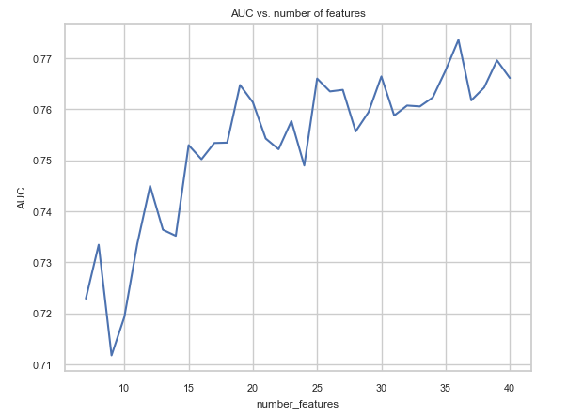
6. Feature selection
Recursive feature Elimination RFE: Fits a model and removes the weakest feature (or features) until the specified number of features is reached
Number feature | AUC
7 | 0.72887
8 | 0.733445
9 | 0.711768
10 | 0.719320
11 | 0.733585
12 | 0.744983
13 | 0.736382
14 | 0.735193
15 | 0.752954
16 | 0.750192
17 | 0.753374
18 | 0.753444
19 | 0.764737
20 | 0.761345
21 | 0.754248
22 | 0.752150
23 | 0.757674
24 | 0.748969
Number feature | AUC
25 | 0.765995
26 | 0.763478
27 | 0.763793
28 | 0.755646
29 | 0.759422
30 | 0.766415
31 | 0.758758
32 | 0.760716
33 | 0.760541
34 | 0.762289
35 | 0.767604
36 | 0.773582
37 | 0.761730
38 | 0.764247
39 | 0.769562
40 | 0.766100
Selected Features
Month
credit_amount
credit_term
Age
having_children_flg
Region
Income
phone_operator
is_client
education_Higher education
education_Incomplete higher education
education_Incomplete secondary education
education_Secondary education
education_Secondary special education
product_type_Audio & Video
product_type_Auto
product_type_Boats
product_type_Cell phones
product_type_Clothing
product_type_Computers
product_type_Construction Materials
product_type_Cosmetics and beauty services
product_type_Fitness
product_type_Furniture
product_type_Garden equipment
product_type_Household appliances
product_type_Jewelry
product_type_Medical services
product_type_Sporting goods
product_type_Tourism
product_type_Training
product_type_Windows & Doors
family_status_Another
family_status_Married
family_status_Unmarried
sex_female

Slide 11
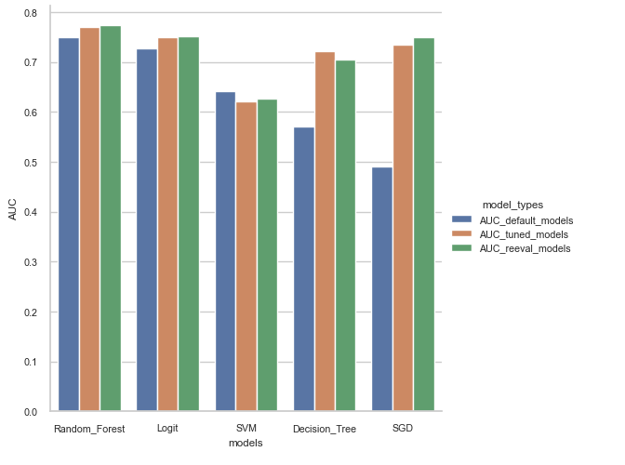
Re-evaluate models with refined dataset
Models | AUC_default_models | AUC_tuned_models | AUC_reeval_models
Random_Forest | 0.74 | 0.77 | 0.77
Logit | 0.72 | 0.74 | 0.75
SVM | 0.64 | 0.62 | 0.62
Decision_Tree | 0.57 | 0.72 | 0.70
SGD | 0.49 | 0.73 | 0.74
The best model after feature selection is Random Forest

Slide 12
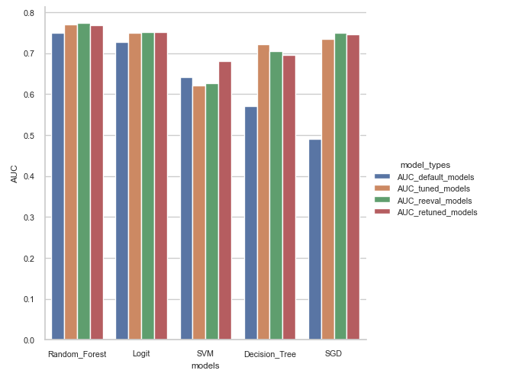

7. Retune model with new refined data
Models | AUC_default_models | AUC_tuned_models | AUC_reeval_models | AUC_retuned_models
Random_Forest | 0.74 | 0.77 | 0.77 | 0.76
Logit | 0.72 | 0.74 | 0.75 | 0.75
SVM | 0.64 | 0.62 | 0.62 | 0.68
Decision_Tree | 0.57 | 0.72 | 0.70 | 0.69
SGD | 0.49 | 0.73 | 0.74 | 0.74
The best model after feature selection and fine tuning is Random Forest

Slide 13
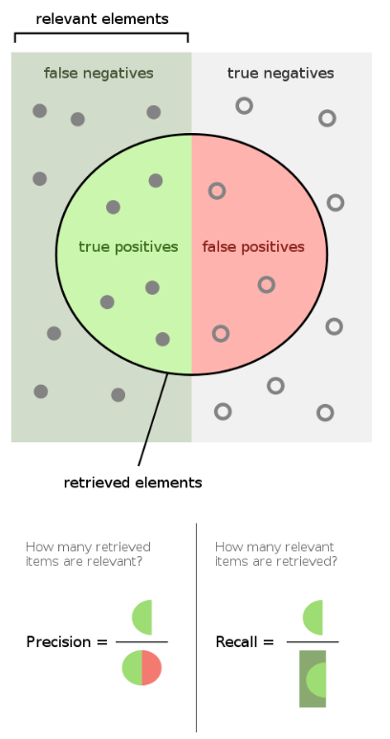
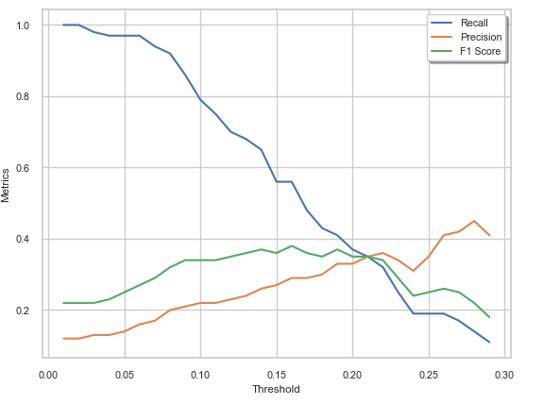

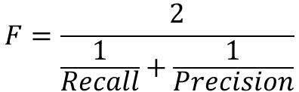
8. Threshold Analysis
$$F=\frac{2}{\frac{1}{Recall}+\frac{1}{Precision}}$$
Selecting the threshold is a trade-off between Recall and Precision
Highest f1 score is at threshold = 0.16
$$F=2 \frac{Precision x Recall}{Precision+Recall}$$

Slide 14
Conclusion
Tuned Random forest, one of the most accurate modelling techniques, is the highest accuracy model after implementing various modelling techniques. To achieve the best prediction results, we need to select a Tuned Random Forest model to identify the bad and good clients of the company.
Business Solution:
When offering a loan to a customer, we recommend that the company concentrate more on underwriting and ensure that the customer has no bad credit history if a woman customer with secondary education requesting a loan for the cell phone products. This solution is recommended because most of these bad customers fall under this category.

